Slide 1

TRIP RATE CHANGES OVER TIME: AN EXAMINATION OF MAIN TRICS LAND USES
MIKE GREEN, SURREY COUNTY COUNCIL
Notes:
In this presentation I shall be speaking about some recent analyses undertaken by TRICS Consortium Limited into trip rate changes over time.

Slide 2
BACKGROUND
TRICS Contains over 30 years of survey data.
Our first analysis of trip rates over time.
Retail, Employment and Residential land uses studied.
Traffic only analysis and multi-modal analysis.
Any trends cannot be assumed to continue in to the future.
Very important that data collection continues so that ongoing trends can be continually assessed.
Be aware of trip rate calculation “cut off” date defaults.
Notes:
So here is some background to this study. As you will all be aware, the TRICS database contains over 30 years of survey data, and we have used this range of available information to ascertain what has been happening to trip rates over that time. This is the first such analysis that TRICS has undertaken, and we looked at Retail (Food Superstore), Employment (Offices) and Residential (Houses Privately Owned) land use categories, as these are some of the most plentiful in terms of the number of surveys within TRICS. We undertook two separate analyses, the first for vehicles only and the second for multi-modal activity. However, there are limitations to this analysis, and we do need to stress that the identified trends cannot be assumed to continue along the same lines as we go into the future, as there are many possible reasons for changes in travel behaviour, and of course these influences may change. However, it does show how important it is for TRICS to continue to collect significant volumes of survey data as we move forward, to ensure that we continue to lead the way in terms of trip generation analysis as we all move forwards. Also note that TRICS automatically selects the latest 8 years worth of survey data when you undertake a trip rate calculation (although this is flexible for users and our Good Practice Guide addresses this in more detail), so you have always had regard to these changes in trip rates even if you were unaware of it.

Slide 3
THE LAND USES
01/A: Food Superstore
02/A: Office
03/A: Houses Privately Owned
Notes:
We identified three land use categories most appropriate for this study, which were Food Superstore, Office and Houses Privately Owned. These cover the “top three” main categories of Retail, Employment and Residential. We felt it was important to keep the analysis nice and straightforward, and we were also aware that with too extensive a criteria we could be in danger of ending up with smaller datasets with which to work with, so it made sense to select these three large land use sub-categories within the database, which are very popular with our users as shown in the responses to our annual User Survey.

Slide 4
TRAFFIC ANALYSIS & MULTI-MODAL ANALYSIS
Traffic Analysis
  Total Vehicles
Multi-Modal Analysis
  Total Vehicles
  Total People
  Pedestrians
  Public Transport users
  Cyclists
Notes:
So we undertook two types of analysis. The first was vehicle only, using the Total Vehicles count in TRICS. The second set looked at multi-modal trips, breaking these down into total vehicles (so that a direct comparison could be made with the vehicles only analysis), then total people, pedestrians, public transport users and cyclists. Note that although TRICS data goes back over 30 years, we only started to collect multi-modal data from the year 2000 onwards, so the multi-modal analysis covered an overall shorter timescale.

Slide 5
CRITERIA OF ANALYSIS: FOOD SUPERSTORES
Survey Dates
  1989-1993
  1994-1998
  1999-2003
  2004-2008
  2009-2013
  2014-2018
  (multi-modal range)
Trip rates (both directions) per 100m2 GFA
Friday Periods
  0800-0900 Morning Peak
  1700-1800 Evening Peak
  0700-1900 (12 Hours)
Saturday Periods
  1200-1300 Peak Hour
  0700-1900 (12 Hours)
Maximum Sample Size: 65 survey days
Edge of Town, Suburban Area and Edge of Town Centre location types combined.
Notes:
Here is the criteria that we used to filter the data in the TRICS trip rate calculation process for the Food Superstore category. On the left we have the date ranges in 5 year blocks. You will see that the yellow range shows the period when multi-modal data was available, as the multi-modal surveys began in the year 2000. So, for the total vehicles analysis we used all ranges from 1989 up to 2018, and for the multi-modal analysis (which we undertook after the initial vehicular analysis), the range was from 1999 until 2018. On the right hand side we have the other selections made. Trip rates for Food Superstores were calculated per 100m2 of Gross Floor Area, with there being three Friday periods and two Saturday periods (the calculations were split between Fridays and Saturdays as trip patterns differ between these two days of the week). The maximum survey sample size at any point was 65 days, and we combined the three main location types of Edge of Town, Suburban Area and Edge of Town Centre. Note that this was necessary in order to achieve reasonable survey sizes for our analyses.

Slide 6
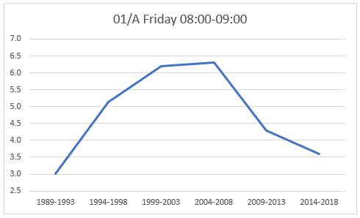
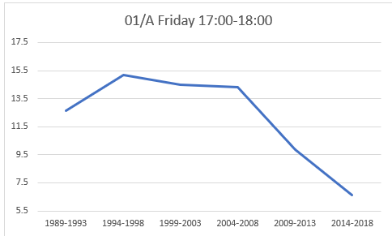
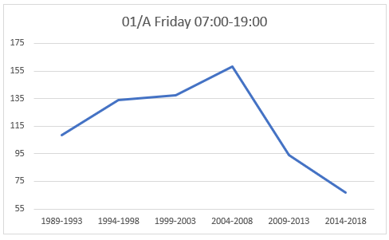
FOOD SUPERSTORE RESULTS: FRIDAYS
TOTAL VEHICLES PER 100m2 GFA
 |  | 1989-1993 | 1994-1998 | 1999-2003 | 2004-2008 | 2009-2013 | 2014-2018
08:00-09:00 |  | 3.013 | 5.128 | 6.204 | 6.315 | 4.286 | 3.605
 |  | 1989-1993 | 1994-1998 | 1999-2003 | 2004-2008 | 2009-2013 | 2014-2018
17:00-18:00 |  | 12.648 | 15.174 | 14.510 | 14.317 | 9.871 | 6.622
 |  | 1989-1993 | 1994-1998 | 1999-2003 | 2004-2008 | 2009-2013 | 2014-2018
07:00-19:00 |  | 108.293 | 133.892 | 137.646 | 158.074 | 93.920 | 67.052
Notes:
So here are the first set of results, Fridays at Food Superstores. We can see the three graphs covering the three time periods of 0800-0900, 1700-1800 and 0700-1900. Note that all trip rates shown are two-way trips (so we have combined arrivals and departures together in all cases). The trip rate is shown on the vertical axis, with the blocks of years increasing from left to right along the horizontal axis. The table underneath the graphs shows the three time periods and the corresponding trip rates per 100m2 (both directions combined) for each block of time, starting at 1989 and ending at 2018. The three graphs are reasonably consistent in that they show an initial increase in trip generation from 1989 and then a decrease from around 2004-2005 onwards.

Slide 7
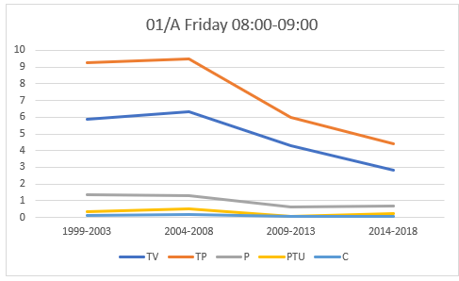
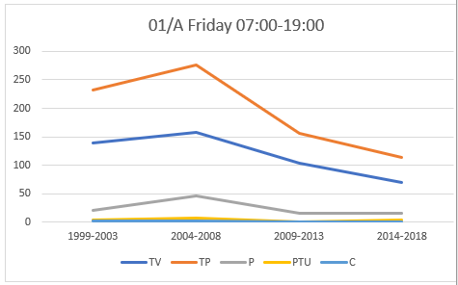
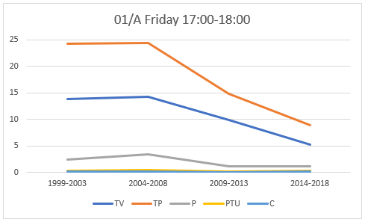
FOOD SUPERSTORE RESULTS: FRIDAYS
MULTI-MODAL TRIPS PER 100m2 GFA
08:00-09:00 |  | 1999-2003 | 2004-2008 | 2009-2013 | 2014-2018
TV |  | 5.897 | 6.315 | 4.286 | 2.833
TP |  | 9.251 | 9.497 | 5.975 | 4.417
P |  | 1.353 | 1.305 | 0.629 | 0.700
PTU |  | 0.369 | 0.522 | 0.042 | 0.232
C |  | 0.114 | 0.166 | 0.045 | 0.042
17:00-18:00 |  | 1999-2003 | 2004-2008 | 2009-2013 | 2014-2018
TV |  | 13.839 | 14.317 | 9.871 | 5.162
TP |  | 24.272 | 24.406 | 14.845 | 8.942
P |  | 2.421 | 3.371 | 1.150 | 1.181
PTU |  | 0.288 | 0.451 | 0.081 | 0.235
C |  | 0.150 | 0.190 | 0.069 | 0.092
07:00-19:00 |  | 1999-2003 | 2004-2008 | 2009-2013 | 2014-2018
TV |  | 139.242 | 158.072 | 102.688 | 68.962
TP |  | 231.851 | 275.760 | 156.303 | 113.595
P |  | 21.097 | 45.916 | 15.775 | 15.607
PTU |  | 4.013 | 7.098 | 0.947 | 3.466
C |  | 1.291 | 1.923 | 0.714 | 0.886
Notes:
Here is the multi-modal analysis of Fridays at Food Superstores. It shows the same three time periods as in the vehicles only analysis, these being 0800-0900, 1700-1800 and 0700-1900. However, this analysis is now broken down into Total Vehicles, Total People, Pedestrians, Public Transport Users and Cyclists. The analysis undertaken is identical to the vehicles only version, but you can now see on the three graphs we have the various modes separately shown, and we can see the varying rates of growth and decline. Without going into too much detail, we can see the overall level of trips reducing for each time period from around 2006 onwards, with the Total Vehicles and Total People numbers appearing to decline at a steeper rate.

Slide 8
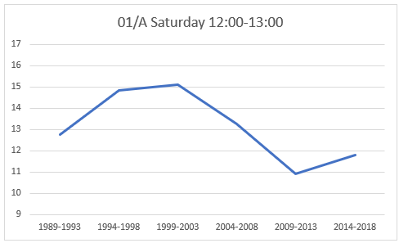
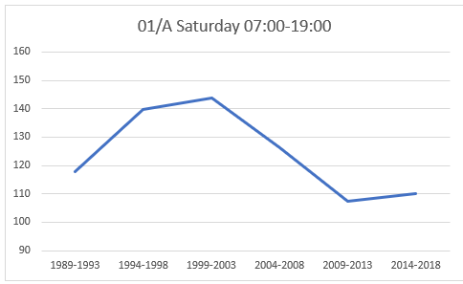
FOOD SUPERSTORE RESULTS: SATURDAYS
TOTAL VEHICLES PER 100m2 GFA
 |  | 1989-1993 | 1994-1998 | 1999-2003 | 2004-2008 | 2009-2013 | 2014-2018
12:00-13:00 |  | 12.752 | 14.837 | 15.112 | 13.278 | 10.902 | 11.779
 |  | 1989-1993 | 1994-1998 | 1999-2003 | 2004-2008 | 2009-2013 | 2014-2018
07:00-19:00 |  | 117.908 | 139.780 | 143.733 | 126.114 | 107.417 | 109.985
Notes:
Then we can look at Food Superstores on Saturdays, this time showing two time periods, 1200-1300 and 0700-1900. Again, like the Friday version, we see an initial increase in vehicular trip generation followed by a steady decrease over time, with a bit of an increase in the final few years of the analysis. Bear in mind that throughout this analysis we may find that smaller data samples and other anomalies may of course have affected the trends. For example, there may have been a particularly busy site thrown into the mix in a smaller data sample, which could lift trip rates accordingly. On the other hand, the opposite could also have happened. Please bear in mind that this is not a complex statistical analysis, it is instead a straightforward look at the TRICS data to ascertain a general idea of trends. We are certainly not aiming to make any future predictions based on this analysis, this really is a first look at the subject of trip rates over time.

Slide 9
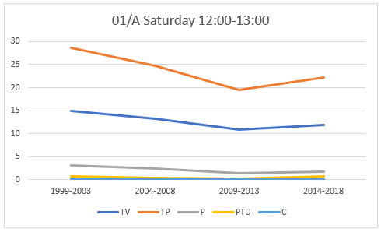
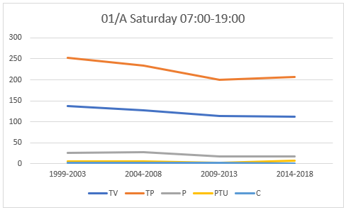
FOOD SUPERSTORE RESULTS: SATURDAYS
MULTI-MODAL TRIPS PER 100m2 GFA
12:00-13:00 |  | 1999-2003 | 2004-2008 | 2009-2013 | 2014-2018
TV |  | 14.997 | 13.278 | 10.902 | 11.913
TP |  | 28.678 | 24.725 | 19.452 | 22.263
P |  | 2.977 | 2.411 | 1.451 | 1.731
PTU |  | 0.716 | 0.415 | 0.248 | 0.671
C |  | 0.247 | 0.151 | 0.093 | 0.070
07:00-19:00 |  | 1999-2003 | 2004-2008 | 2009-2013 | 2014-2018
TV |  | 137.964 | 127.272 | 114.320 | 111.650
TP |  | 253.059 | 234.507 | 199.527 | 206.859
P |  | 25.908 | 26.812 | 16.608 | 16.787
PTU |  | 4.967 | 4.532 | 2.490 | 6.688
C |  | 1.757 | 1.400 | 1.057 | 0.889
Notes:
And here is the Saturday multi-modal analysis for Food Superstores. This shows a gradual decrease in trip rates over time, with a levelling off evident for the 0700-1900 period. For the 1200-1300 period we see a slight increase after around 2011, but again be aware of the possible anomalies that I just mentioned.

Slide 10
CRITERIA OF ANALYSIS: OFFICES
Survey Dates
  1989-1993
  1994-1998
  1999-2003
  2004-2008
  2009-2013
  2014-2018
  (multi-modal range)
Trip rates (both directions) per 100m2 GFA
Weekday (Monday-Friday) Periods
  0800-0900 Morning Peak
  1700-1800 Evening Peak
  0700-1900 (12 Hours)
Maximum Sample Size: 45 survey days
Edge of Town, Suburban Area and Edge of Town Centre location types combined.
Notes:
So now let’s look at Offices. We undertook a weekday analysis for this land use category, again splitting it by vehicles only and multi-modes. Again, we calculated trip rates per 100m2 of Gross Floor Area, and this time we included the three time periods of 0800-0900, 1700-1800 and 0700-1900. The maximum survey sample size at any one point was 45 days, and again we combined the three main location types to maximise these samples.

Slide 11
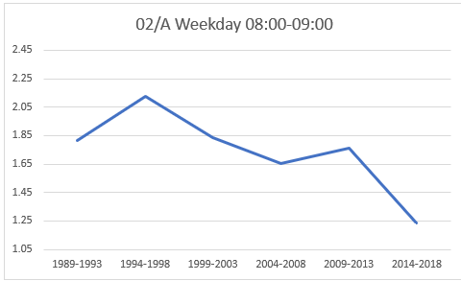
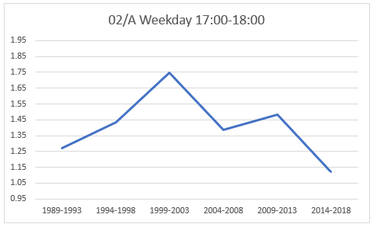
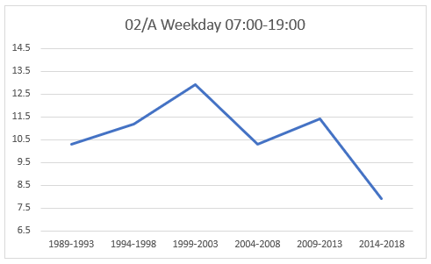
OFFICE RESULTS: WEEKDAYS
TOTAL VEHICLES PER 100m2 GFA
 |  | 1989-1993 | 1994-1998 | 1999-2003 | 2004-2008 | 2009-2013 | 2014-2018
08:00-09:00 |  | 1.814 | 2.127 | 1.837 | 1.656 | 1.765 | 1.235
 |  | 1989-1993 | 1994-1998 | 1999-2003 | 2004-2008 | 2009-2013 | 2014-2018
17:00-18:00 |  | 1.273 | 1.435 | 1.746 | 1.385 | 1.484 | 1.120
 |  | 1989-1993 | 1994-1998 | 1999-2003 | 2004-2008 | 2009-2013 | 2014-2018
07:00-19:00 |  | 10.298 | 11.193 | 12.929 | 10.292 | 11.398 | 7.902
Notes:
The vehicular analysis for weekday activity at Offices is shown here. Similar to Food Superstores, we are seeing an initial increase in trip rates across the three time periods analysed, followed by a decrease, with there being a relatively steep decline in the final period of the analysis ending in 2018.

Slide 12
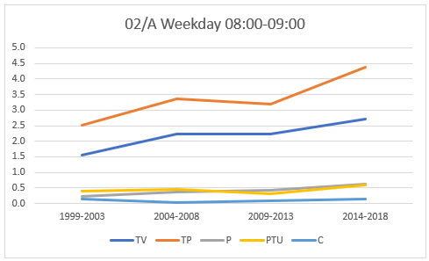
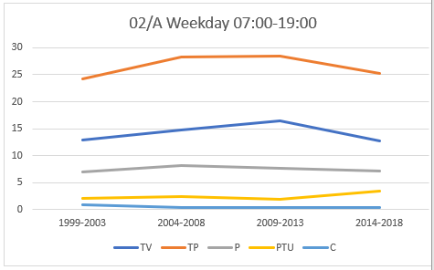
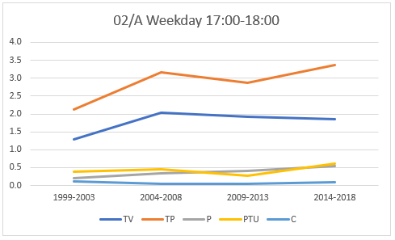
OFFICE RESULTS: WEEKDAYS
MULTI-MODAL TRIPS PER 100m2 GFA
08:00-09:00 |  | 1999-2003 | 2004-2008 | 2009-2013 | 2014-2018
TV |  | 1.542 | 2.225 | 2.228 | 2.714
TP |  | 2.509 | 3.361 | 3.200 | 4.373
P |  | 0.221 | 0.381 | 0.421 | 0.611
PTU |  | 0.411 | 0.445 | 0.305 | 0.594
C |  | 0.154 | 0.041 | 0.088 | 0.138
17:00-18:00 |  | 1999-2003 | 2004-2008 | 2009-2013 | 2014-2018
TV |  | 1.293 | 2.045 | 1.920 | 1.860
TP |  | 2.126 | 3.173 | 2.860 | 3.356
P |  | 0.211 | 0.349 | 0.415 | 0.541
PTU |  | 0.375 | 0.449 | 0.263 | 0.614
C |  | 0.125 | 0.056 | 0.058 | 0.103
07:00-19:00 |  | 1999-2003 | 2004-2008 | 2009-2013 | 2014-2018
TV |  | 12.822 | 14.788 | 16.518 | 12.674
TP |  | 24.203 | 28.224 | 28.385 | 25.213
P |  | 6.872 | 8.126 | 7.578 | 7.122
PTU |  | 2.077 | 2.415 | 1.824 | 3.328
C |  | 0.880 | 0.299 | 0.348 | 0.395
Notes:
The multi-modal analysis for Offices presents us with something a bit different. Looking at Total People, the 0800-0900 and 1700-1800 periods suggest an increase in trips over time, but then when you look at the bigger picture, the full day 0700-1900 period, you see the similar growth in trips followed by a decline, although in the case of Offices this appears to more subtle (less steep) than what we saw previously for Food Superstores. I would suggest that the 0700-1900 graph, giving a fuller picture, could be considered more representative overall if we are looking for the total number of trips and not just the main commute times. Once again, any anomalies that you see may be due to the nature of the individual sites and the survey sample sizes. We are merely reporting the data as directly extracted from the TRICS surveys, and we offer no further speculation.

Slide 13
CRITERIA OF ANALYSIS:
HOUSES PRIVATELY OWNED
Survey Dates
  1989-1993
  1994-1998
  1999-2003
  2004-2008
  2009-2013
  2014-2018
  (multi-modal range)
Trip rates (both directions) per 1 Dwelling
Weekday (Monday-Friday) Periods
  0800-0900 Morning Peak
  1700-1800 Evening Peak
  0700-1900 (12 Hours)
Maximum Sample Size: 64 survey days
Edge of Town, Suburban Area and Edge of Town Centre location types combined.
Notes:
And so we move on to the third and final sets of analyses, the Houses Privately Owned land use category. As before, we included the same three time periods with a weekday analysis being undertaken. And the maximum sample size at any point was 64 days. Again. We combined the three main location types to maximise data samples. Note that the calculations for this land use are displayed in the results per 1 dwelling.

Slide 14
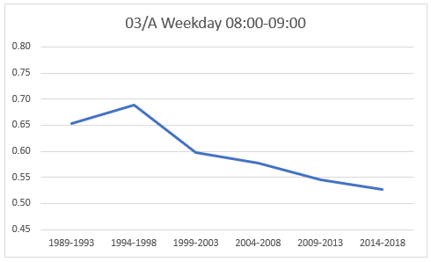
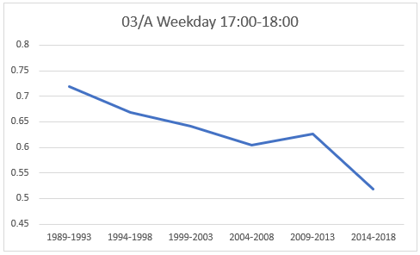
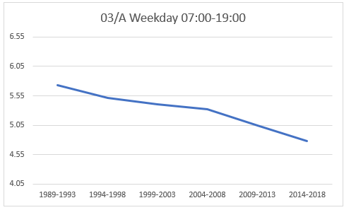
HOUSES PRIVATELY OWNED RESULTS:
WEEKDAYS – TOTAL VEHICLES PER 1 DWELLING
 |  | 1989-1993 | 1994-1998 | 1999-2003 | 2004-2008 | 2009-2013 | 2014-2018
08:00-09:00 |  | 0.654 | 0.688 | 0.597 | 0.578 | 0.546 | 0.527
 |  | 1989-1993 | 1994-1998 | 1999-2003 | 2004-2008 | 2009-2013 | 2014-2018
17:00-18:00 |  | 0.719 | 0.668 | 0.642 | 0.605 | 0.627 | 0.518
 |  | 1989-1993 | 1994-1998 | 1999-2003 | 2004-2008 | 2009-2013 | 2014-2018
07:00-19:00 |  | 5.733 | 5.509 | 5.408 | 5.323 | 5.044 | 4.774
Notes:
Here are the vehicular results for Houses Privately Owned on weekdays. The graphs appear straightforward and indicate a steady decline in trips for each of the three time periods. Again, the trip rates displayed here are per 1 dwelling.

Slide 15
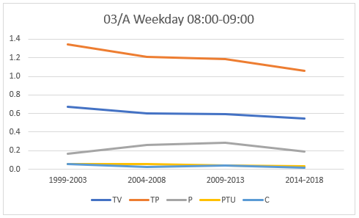
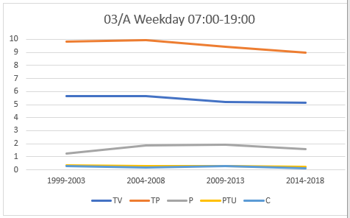
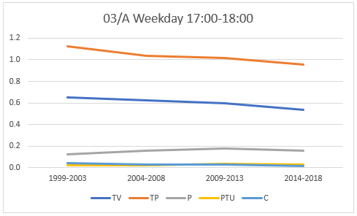
HOUSES PRIVATELY OWNED RESULTS:
WEEKDAYS - MULTI-MODAL TRIPS PER 1 DWELLING
08:00-09:00 |  | 1999-2003 | 2004-2008 | 2009-2013 | 2014-2018
TV |  | 0.672 | 0.602 | 0.594 | 0.548
TP |  | 1.348 | 1.209 | 1.186 | 1.062
P |  | 0.169 | 0.261 | 0.283 | 0.193
PTU |  | 0.053 | 0.057 | 0.043 | 0.031
C |  | 0.052 | 0.022 | 0.039 | 0.013
17:00-18:00 |  | 1999-2003 | 2004-2008 | 2009-2013 | 2014-2018
TV |  | 0.651 | 0.624 | 0.599 | 0.533
TP |  | 1.126 | 1.037 | 1.014 | 0.959
P |  | 0.123 | 0.153 | 0.178 | 0.153
PTU |  | 0.023 | 0.020 | 0.033 | 0.025
C |  | 0.040 | 0.025 | 0.028 | 0.014
07:00-19:00 |  | 1999-2003 | 2004-2008 | 2009-2013 | 2014-2018
TV |  | 5.623 | 5.671 | 5.209 | 5.156
TP |  | 9.815 | 9.921 | 9.420 | 8.994
P |  | 1.252 | 1.881 | 1.937 | 1.591
PTU |  | 0.317 | 0.273 | 0.304 | 0.221
C |  | 0.280 | 0.178 | 0.279 | 0.119
Notes:
The multi-modal results for Houses Privately Owned is the final results slide. This does indicate some reduction in trips over time, but it appears more gradual than the vehicular analysis. Again, this could be explained by data samples and other effects.

Slide 16
NON-SPECULATIVE SUMMARY
This limited analysis undertaken by TRICS shows, for a small number of land use categories, an apparent reduction in vehicle trips over time.
This is also evident to a certain degree for total people trips, although these appear to be more dynamic. Individual modes show more inconsistent trends.
An overall shift towards non-vehicular modes is also suggested.
TRICS provides a cut-off date in the calculation process and also provides guidance on its use (see Good Practice Guide).
Notes:
So, to summarise our findings without being too speculative, we can see that this limited analysis shows, for a small number of land use categories, a general apparent reduction in vehicle trips over time. This is also evident to a certain degree for total people trips, although these appear to be more dynamic. Individual modes show more inconsistent trends. However, it would appear from this limited exercise that an overall, general shift towards non-vehicular modes is suggested. It should be noted that, by default, TRICS has an 8-year cut-off in place when undertaking trip rate calculations. However, we do understand that at times users may need to extend this cut off period in instances where a data sample may be considered very small, and our Good Practice Guidance provides further detail about this. So within TRICS there has always been an element of date-consciousness. It is up to our users to decide on a case by case how to apply cut-off dates, and we urge you to do so using your professional judgement. Also, we do need to again remind you that this is just an initial, straightforward type of analysis, undertaken using the TRICS system to calculate trip rates, and that any anomalies that may have appeared in the results could have been caused by a variety of factors. But this has been a worthwhile exercise that has provided some interesting observations for discussion. What is clear from this exercise is that TRICS needs to continue to undertake large numbers of surveys as we move forwards, as we look to continue to monitor trends over time. We could well be repeating this exercise at regular intervals in the future as we consider this work of good value.

Slide 17
FURTHER DISCUSSION NEEDED
There are many different influences to Travel Behaviour.
How will these changes impact Trip Generation in the future?
Continued Independent Surveys will help inform historic trends
TRICS - Changes in Behaviours Guidance
Notes:
TRICS is aware that there are many different influences to Travel Behaviour. One thing is certain, our changes in behaviour will continue to influence Trip Rates as we move forward, which way they will go is the big question. The continued undertaking of independent surveys is the only way to see how things are changing and without this information our Industry will be unaware of these changes.
The big question is how we use this information to ensure we are moving forward. Well funnily enough, the last paper and forum today will hopefully start to look into this.

